Slide 1
IB English Language and Literature
6 ELL SL 4
2019 - 2020
Shape of the Week (7):
Lesson 1: Finish Propaganda/ Speech Vocabulary
Lesson 2: Speeches - Listening and Analysis
Lesson 3: Speech Vocab Test/ Speech Vocab Test/ Written Task

Slide 2

ASSESSMENT TERM 1
School (Report SA)
☑ Paper 1 Commentary [EXAM Rubric] Week 4 100%
IB Assessment
☑ IB FOA 2: Gender in Ads Proposal due week 6 due Tuesday 11th Feb, FOA given week 1&2 term 2
☑ IB WT 2: Speeches/ Letters, First Draft Proposal Week 10, finished proposal week 1.

Slide 3

Homework
Bert the Turtle and other propaganda films (MB) Tuesday 18th
https://www.youtube.com/watch?reload=9&v=7A2BxcrZh-E&list=RDIOT16v5lCjw&index=22

Slide 4
Lesson 1: Bert the Turtle/ Vocab for Speeches
☑ Bert/ Daisy/ Mao
☑ Vocab for Speeches.

Slide 5
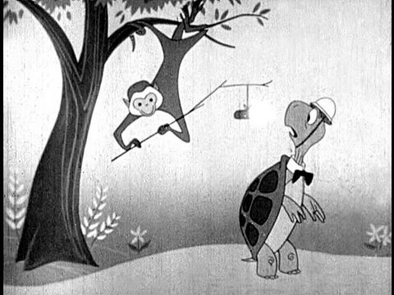
Duck and Cover/ The Daisy Ad
Like the 80s, these are part of my family history – these things were actually shown and were taken seriously!
How does Bert the Turtle try to create reassurance? (Narrator: It did not reassure).
How does the Daisy Ad try to create alarm?

Slide 6
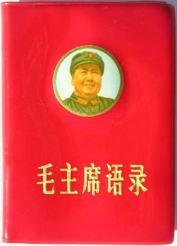
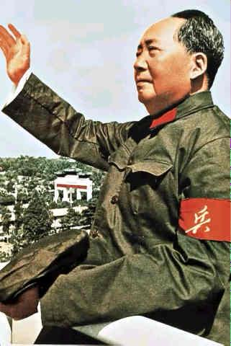
Mao Tse Tung 1893-1976

Slide 7
Mao Zedong, also known as Mao Tse-Tung was the son of a peasant and was born in Chaochan, China in 1893.
He became Marxist while working as a library assistant at Peking University.
He served in the revolutionary army during the 1911 Chinese Revolution.
In 1921, the Chinese Communist Party was established and Mao Zedong was one of the first members along with Zhoa Enlai, Zhu De and Lin Biao. After the party was established, Mao started studying the Ideas and Policies of Vladimir Lenin. He studied him because he successfully revolutionized Russia and started the Communist party there.

Slide 8
In October, 1949, he announced the starting of the People's Republic of China. He was the leader and started an Industrial and cultural revolution known as "The Great Leap Forward". It was an attempt by Mao to re-impose his authority on the party and therefore the country.
Mao deliberately set out to create a cult for himself and to purge the Chinese Communist Party of anyone who did not fully support him. His main selling point was a desire to create a China which had peasants, workers and educated people working together – no-one was better than anyone else and all working for the good of China – a classless society.
The Cultural Revolution ended in October, 1968 when Liu Shaoqi resigned from his position in government. Mao died in Beiijing on September 9, 1976.

Slide 9
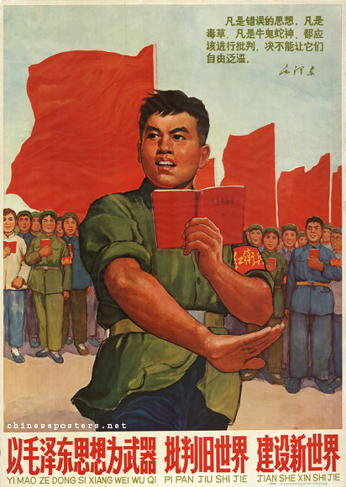
Cultural Revolution 1965 - 1968
The Little Red Book features quotations from Mao's writings. It is small and bound in a red plastic cover so you can always carry it with you. A good Red Guard knows the book by heart and rarely reads anything else.

Slide 10
Quotations from Chairman Mao
The Quotations from Chairman Mao, the Mao zhuxi yulu (毛主席语), 426 in total, were culled from the numerous writings in which Mao had set out to signify Marxism-Leninism over the years and which had been brought together in the four-volume Selected Works of Mao Zedong.
Already in Yan'an, Mao was styling himself as the sole theoretician of Chinese communism, on a par with and later even superseding, Marx, Engels, Lenin and Stalin.
As a result of Mao's (re-)interpretations of the Marxist Classics, his writings became known as Mao Zedong Thought. The Quotations were first published in 1961 for use in the People's Liberation Army under Lin Biao.

Slide 11
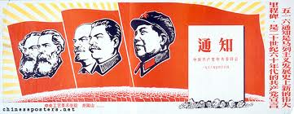
In the early 1960s, and during the first phase of the Cultural Revolution, the PLA played a major role in the popularization of the Quotations.
According to Lin, "Everything that Mao Zedong says is the truth; every statement he utters is worth 10,000 sentences."
The more wide-spread the study of the book, the more devastating the effects that were ascribed to it.
In 1960, Mao Thought was seen as an arrow aimed at the target of revolution; by 1965, the Quotations were seen as a mighty "ideological weapon" in the struggle against imperialism, revisionism and dogmatism.
One year later, Mao Thought had grown into a "spiritual atom bomb" of infinite power.

Slide 12
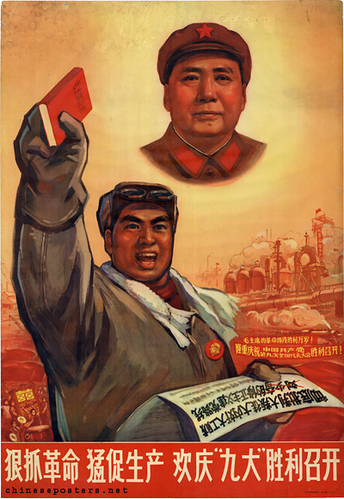

Slide 13
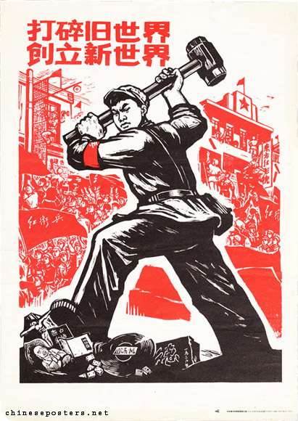
Scatter the old world, build a new world
A Red Guard at work. The smashing is not just meant symbolically. Property of 'rightists', monasteries, temples and other things considered old, bourgeois or decadent are literally smashed to pieces.

Slide 14
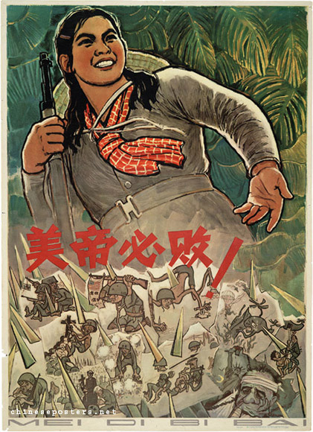
Down with Imperialism! – 1961-1966
The Vietnam War escalates around 1965. America supports the South, China the (communist) North.

Slide 15
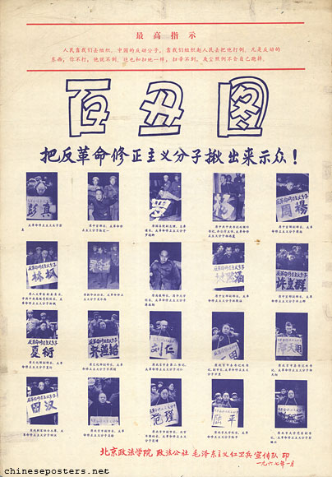
One Hundred Clowns - Drag out the counterrevolutionary revisionist elements and expose them! (1967)
Especially in the early phase of the Cultural Revolution, people are 'dragged out' by Red Guards and forced to wear caps, collars or placards identifying them as 'monsters', 'demons' or 'clowns' during humiliating public meetings.

Slide 16
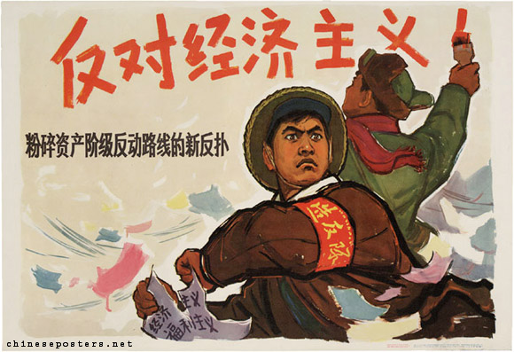
Oppose economism: destroy the new counter-offensive of the capitalist class reactionary line (1967)
'Economism' is one of the tendencies combatted in the early phase of the Cultural Revolution. Economism simply means that economical factors have priority over political and ideological factors, an idea opposed by Mao and his supporters.

Slide 17
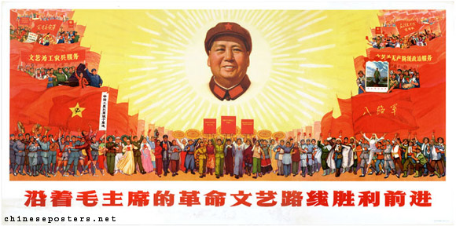
Advance victoriously while following Chairman Mao's revolutionary line in literature and the arts (1968)
At the height of the Mao worship, Mao appears as radiant sun, high above the masses. The dancing figures are from the revolutionary model operas developed by Mao's wife Jiang Qing.

Slide 18
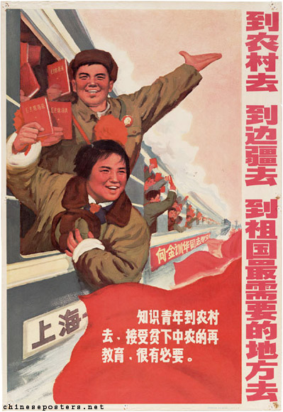
To villages we go, to the borders we go, to places in the fatherland where we are most needed we go (1970)
From late 1968, millions of youth are sent from the cities to the countryside to learn from the peasants. This is meant to end the chaos and the struggle for power among the Red Guard groups.

Slide 19
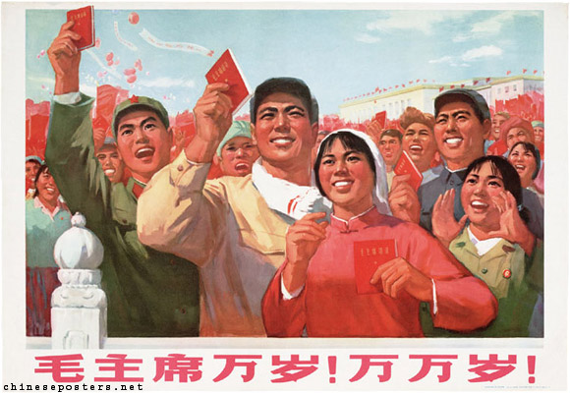
Long live chairman Mao! Long, long live! (1970)
People are on Tiananmen Square in Beijing, waving Little Red Books. They are looking towards the balcony where Mao appears a few times every year, for the commemoration of the proclamation of the People's Republic on 1 October or Labor Day on 1 May.

Slide 20

Carry out birth planning for the revolution (1974)
An intensive campaign for birth control is started in the 1970s. Contraceptives, such as the pill, are free.

Slide 21
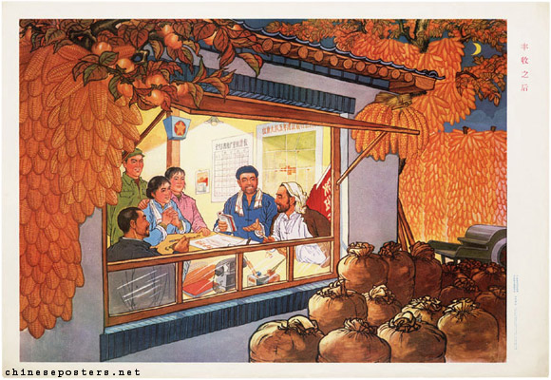
After the bumper harvest (1974)
The leaders of a production brigade discuss the successful harvest.

Slide 22
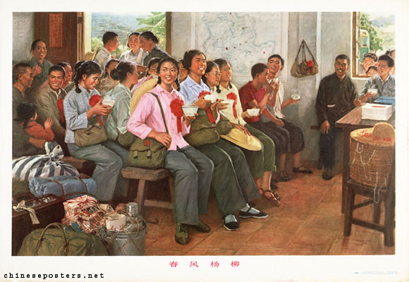
Spring breeze in Yangliu (1975)
Fresh-eyed youngsters from the city arrive in the countryside for resettlement. During the Cultural Revolution an estimated 12 million boys and girls were sent 'Up to the mountains, down to the villages’ in order to be re-educated by the poor and lower-middle peasants.

Slide 23
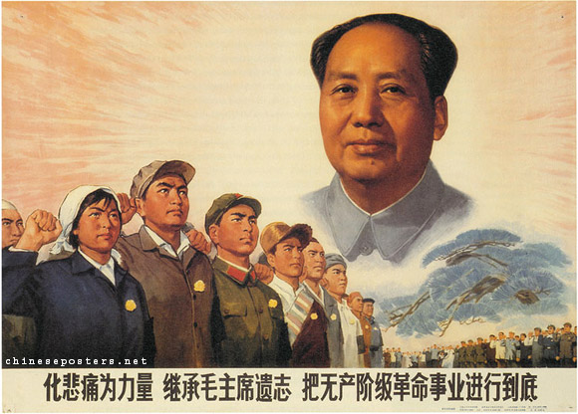
Turn grief into strength, carry out Chairman Mao’s behests and carry the proletarian revolutionary cause through to the end (1976)
Mao dies on 9 September, 1976. There is grief and public mourning, but also an extreme sense of insecurity and even relief. Nobody can predict who will come to power now, or which political direction will prevail.

Slide 24

Vocabulary of Speeches divide up and define from MB
Rhetoric
Anaphora
Repetition
Antistrophe
Restatement (Tautology)
Asyndeton
Parallelism
Rhetorical Questions
Irony
Analogy
Positive Vocabulary
Negative Vocabulary
Exaggeration
Understatement
Quotations
Literary Sound Devices
Literary Figurative Speech
Metonymy
Word Play
Tone

Slide 25

Homework
Complete the Orwell Analysis in hard copy. Use resources on MB.

Slide 26
IB English Language and Literature
6 ELL SL 4
2019 - 2020
Shape of the Week (7):
Lesson 1: Finish Propaganda/ Speech Vocabulary
Lesson 2: Speeches - Listening and Analysis
Lesson 3: Speech Vocab Test/ Written Task

Slide 27
ASSESSMENT TERM 1
School (Report SA)
☑ Paper 1 Commentary [EXAM Rubric] Week 6 100%
IB Assessment
☑ IB FOA 2: Gender in Ads Proposal due week 6 due Tuesday 11th Feb, FOA given week 1&2 term 2
☑ IB WT 2: Speeches/ Letters, First Draft Proposal Week 10, finished proposal week 1.

Slide 28
Homework
Complete the Orwell Analysis in hard copy. Use resources on MB.

Slide 29
Lesson 2: Speeches - Listening and Analysis
☑ Hand up Orwell doc for analysis Friday.
☑ Listening/ Analysing a speech.
☑ Check times for FOA proposal.

Slide 30
Vocabulary of Speeches divide up and define from MB
Rhetoric
Anaphora
Repetition
Antistrophe
Restatement (Tautology)
Asyndeton
Parallelism
Rhetorical Questions
Irony
Analogy
Positive Vocabulary
Negative Vocabulary
Exaggeration
Understatement
Quotations
Literary Sound Devices
Literary Figurative Speech
Metonymy
Word Play
Tone

Slide 31

Analysing Prepared Speech
L.O. To know the framework for analysing planned speech.

Slide 32
Step 1 – G.A.P
Consider the genre (context) audience & purpose.
What is the speech intended to achieve?
He wanted Americans to support him and his cause. Listening to the speech he wanted them to take action for his cause by having a tough stance against USSR.
Who will hear the speech?
Specifically Americans but also the world wide audience
What is the medium of delivery?

Slide 33
Step 2 – Methods
How does the speaker address their audience?
Rhetorical questions, exclamations, undermining the opponent, personal guarantees, tone,
Consider:
Pronouns
Rhetorical questions
Tone
Humour
Shock tactic/undermining the opponent/personal guarantees
exclamations

Slide 34
Step 3 – Structural Features
Analyse the arrangement of the content of the speech – building to a climax, coherence of the text.
Consider:
Listing
Repetition
Opposites
Paragraph and sentence structure/types.

Slide 35
Step 4 – Phonology
Analyse the sound qualities of the language that is used to enhance certain effects.
Alliteration (plosive and fricative sounds)
Sibilance
Assonance
Consonance
Rhyme
Stress

Slide 36
Things to Remember
Analysing planned speech is like analysing writing. You must get the most out of every quotation.
So while it is important to comment on the speech feature used by a speaker – you must also comment on the lexical choices used and the connotations that word type or phrase has for the audience.
You must also always link back to the G.A.P throughout.

Slide 37
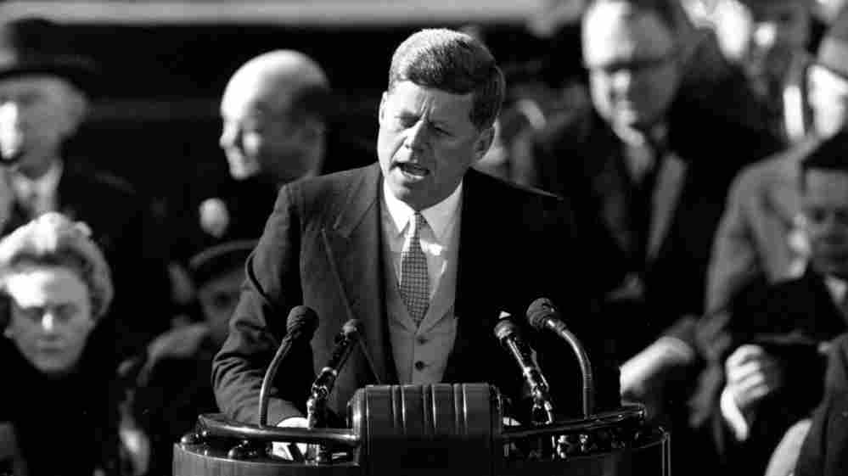
Analysing a SPEECH
This may be something that you have to do on PAPER 1. Plus, it will help you prepare your own speech for the WRITTEN TASK 1 2020.
Go to Managebac and open the 3 documents attached for today’s lesson: the PowerPoint and 2 documents.
Read the PDF along with the speech. Complete the 4 step analysis from the PPT and answer the questions on the word document with your group. I should hear and see lots of good discussion!

Slide 38
Homework
Vocab Test Friday 21st.
Use resources on MB.

Slide 39
Rhetorical Analysis of Speeches

Slide 40
What is Rhetoric? Some Famous Definitions
Plato: [Rhetoric] is the “art of enchanting the soul.” (The art of winning the soul by discourse.)
Aristotle: Rhetoric is “the faculty of discovering in any particular case all of the available means of persuasion.”
Cicero: “Rhetoric is one great art comprised of five lesser arts: inventio, dispositio, elocutio, memoria, and pronunciatio.” Rhetoric is “speech designed to persuade.”

Slide 41
What is Rhetoric? Some Famous Definitions
Quintilian: “Rhetoric is the art of speaking well.”
Francis Bacon: “The duty and office of rhetoric is to apply reason to imagination for the better moving of the will.”
George Campbell: [Rhetoric] is “that art or talent by which discourse is adapted to its end. The four ends of discourse are to enlighten the understanding, please the imagination, move the passion, and influence the will.”

Slide 42
Common Rhetorical Devices
Repetition of a word or phrase at the beginning (anaphora) or end (antistrophe) of successive phrases, clauses or lines.
  "We shall not flag or fail. We shall go on to the end. We shall fight in France, we shall fight on the seas and oceans, we shall fight with growing confidence and growing strength in the air, we shall defend our island, whatever the cost may be, we shall fight on the beaches, we shall fight on the landing grounds, we shall fight in the fields and in the streets, we shall fight in the hills. We shall never surrender.“
  British Prime Minister Winston Churchill

Slide 43
Anaphora repetition of the beginnings of phrases, clauses or sentences)
“Now is the time to help families with paid sick days and better family leave ..... Now is the time to change our bankruptcy laws ...... Now is the time to keep the promise of equal pay for an equal day's work.”
    Democratic nomination acceptance, Barack Obama

Slide 44
ANTISTROPHE – repetition of the ending of successive clauses or sentences
"In 1931, ten years ago, Japan invaded Manchukuo -- without warning. In 1935, Italy invaded Ethiopia -- without warning. In 1938, Hitler occupied Austria -- without warning. In 1939, Hitler invaded Czechoslovakia -- without warning. Later in 1939, Hitler invaded Poland -- without warning. And now Japan has attacked Malaya and Thailand -- and the United States -- without warning.”
      Franklin Delano Roosevelt’s announcement of the attack on Pearl Harbor

Slide 45
Common Rhetorical Devices
Restatement (Tautology): repetition of an idea in a different word, phrase, or sentence.
  "With malice toward none, with charity for all."
  President Abraham Lincoln, Second Inaugural

Slide 46
Common Rhetorical Devices
Asyndeton: lack of conjunctions between coordinate phrases, clauses, or words.
  "We shall pay any price, bear any burden, meet any hardships, support any friend, oppose any foe to assure the survival and the success of liberty."
  J. F. Kennedy, Inaugural
  "But, in a larger sense, we cannot dedicate, we cannot consecrate, we cannot hallow this ground."
  President Abraham Lincoln, Gettysburg Address

Slide 47
Common Rhetorical Devices
Parallelism is repeated grammatical forms. Several parts of a sentence or several sentences are expressed similarly to show that the ideas in the parts or sentences are equal in importance.
For example, parallelism can repeat the verb+ing, or verb+ed form, or have several adverbs using –ly.

Slide 48
(PARALLELISM)
“…we shall pay any price, bear any burden, meet any hardship, support any friend, oppose any foe…”
  inaugural address, John F. Kennedy

Slide 49
Rhetorical Questions
A rhetorical question is a figure of speech in the form of a question posed for its persuasive effect without the expectation of a reply (e.g.: "Why me?")
  Rhetorical questions encourage the listener to think about what the (often obvious) answer to the question must be. When a speaker states, "How much longer must our people endure this injustice?", no formal answer is expected. Rather, it is a device used by the speaker to assert or deny something.

Slide 50
Famous Rhetorical Questions
In William Shakespeare’s The Merchant of Venice, the character Shylock uses rhetorical questions to point out that Jewish people are like non-Jews and therefore should not be treated with discrimination:
  Hath not
  a Jew eyes? hath not a Jew hands, organs,
  dimensions, senses, affections, passions? . . .
  If you prick us, do we not bleed? if you tickle us, do we not laugh? if you poison us, do we not die? And if you wrong us, shall we not revenge?
        Act III, scene i : lines 55 – 63

Slide 51
Irony
Irony: expression of something which is contrary to the intended meaning; the words say one thing but mean another.
  *Yet Brutus says he was ambitious;
  And Brutus is an honourable man.
  Shakespeare's Mark Antony in "Julius Caesar"

Slide 52
Argument by Analogy
Shows a parallel between two basically dissimilar events or situations.
In an argument by analogy it is claimed that if two things have certain characteristics (A) in common, then they are also probably have one or more additional traits (B) in common. When done well the argument can lead to an increase in knowledge.

Slide 53
Examples of Arguments by Analogy
St Paul compares the Christian Church, in the Twelfth Chapter of his Epistle to the Romans to a living organism
  "For as we have many members (i.e., limbs, organs, etc.) in one body, and all members have not the same office (i.e., duty), so we, being many, are one body in Christ, and every one members one of another."

